Slide 1

April 14, 2020
The 4Ms in Telehealth visits
Andrea Wershof Schwartz, MD MPH
VA Boston Division of Geriatrics & Palliative Care
Assistant Professor of Medicine, Harvard Medical School
New England GRECC/Geriatrics Research, Education and Clinical Center

Slide 2

The 4Ms in Telehealth visits

Slide 3
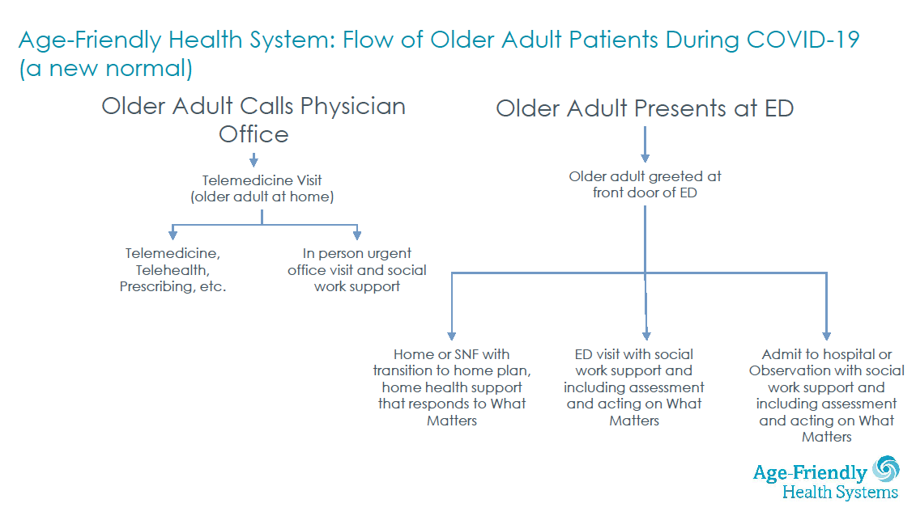
Telehealth: the new normal

Slide 4

The 4Ms in Telehealth

Slide 5
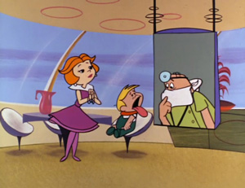
Synchronous Live Video Telehealth
Setting
Clinic
Home
Ambulance
Nursing home
Patient Population
Primary Care
Specialty Care
Mental Health
Image source: The Jetsons, 1962 via ottawaheart.ca
Notes:
Image source:
Hanna-Barbera’s 1962 animated sitcom, The Jetsons
Image source: https://www.ottawaheart.ca/the-beat/2018/02/07/modern-day-healthcare-first-envisioned-1962-classic-jetsons

Slide 6
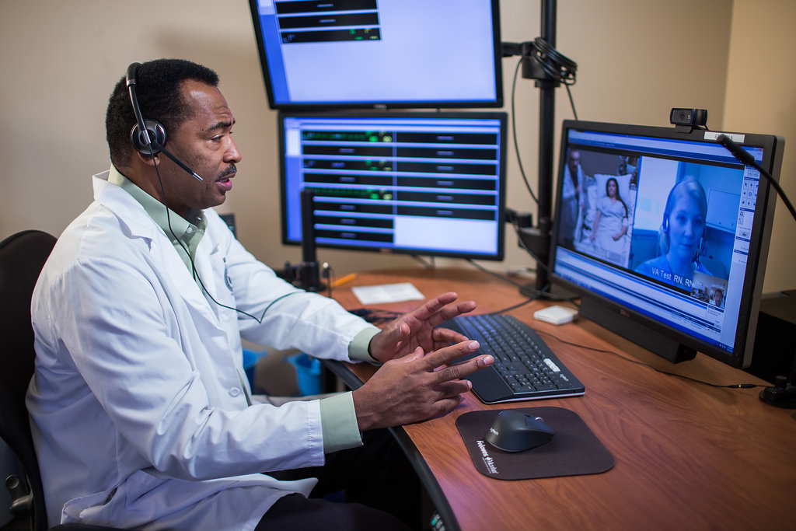
Synchronous Live Video Telehealth
Image source: Telehealth.va.gov
Notes:
Image source:
https://www.ncbi.nlm.nih.gov/pmc/articles/PMC1775394/pdf/amjph00802-0021.pdf

Slide 7
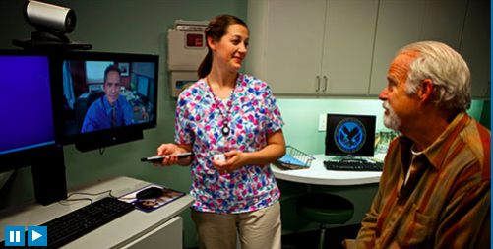
Synchronous Live Video Telehealth
Image source: Telehealth.va.gov
Notes:
Image source:
telehealth.va.gov

Slide 8


Synchronous Live Video Telehealth
Clinical setting to clinical setting Clinician to Patient
Image source: Online Doctor By IconTrack Licensed to Andrea Schwartz via thenounproject.com
VA Health from https://mobile.va.gov/app/va-video-connect
Notes:
Image source:
Online Doctor
By IconTrack
Licensed to Andrea Schwartz via thenounproject.com

Slide 9

Prior to 2020, had you practiced Telehealth?
Yes/No/Not sure
If so, what setting?
Since 2020?
What are some challenges in Telehealth?

Slide 10
Clinician Training in Telehealth
Very few clinicians have received training in Telehealth, little published literature (Edirippulige et al, J Telemed, 2017; List et al, J Nurse Ed 2019)
Most receive online training only, not clinical or skill based (Rienets et al, Clinical Teacher, 2016, Rutledge et al, Adv in Med Ed, 2017, Guise et al, BMC Health Serv Res, 2017)
Patients report high satisfaction with Telehealth (Becevic et al, Health Care Man 2015, ; Polinski et al, JGIM 2015, telehealth.va.gov)

Slide 11
Televisit Tips using the 4Ms
Setup
History
Physical
A/P
Notes:
Image source:
Doctor
By Wilson Joseph
Licensed to Andrea Schwartz via thenounproject.com

Slide 12

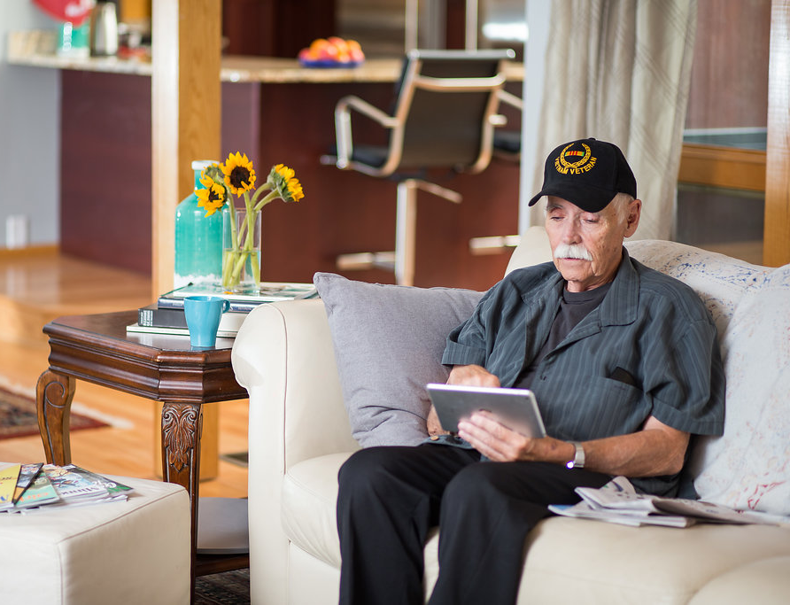
Setup
History
Physical
A/P
Image source: telehealth.va.gov
Notes:
Image source:
Doctor
By Wilson Joseph
Licensed to Andrea Schwartz via thenounproject.com

Slide 13

Setup
History
Physical
A/P
Focus on the patient, not the platform
Lights: bright enough? Solid top.
Camera: look at the patient, not the screen, be mindful of keyboard
Action: “Webside Manner”
Who:
Patient Caregiver
Interpreter
Interprofessional team members
Trainees’ roles
Image source: Doctor By Wilson Joseph Licensed to Andrea Schwartz via thenounproject.com
Notes:
Image source:
Doctor
By Wilson Joseph
Licensed to Andrea Schwartz via thenounproject.com

Slide 14
Setup
History
Physical
A/P
What:
Camera & Microphone quality
Internet/wireless quality
Do you have everything you need within reach?
When:
Urgent/on demand visits
Patient or clinician initiated
Medical assistant/tech role
Image source: Doctor By Wilson Joseph Licensed to Andrea Schwartz via thenounproject.com
Notes:
Image source:
Doctor
By Wilson Joseph
Licensed to Andrea Schwartz via thenounproject.com

Slide 15
Setup
History
Physical
A/P
Where:
911 plan/location info
Technology backup plan
Scan and lock the virtual room
How:
Hearing Impairment:
Headphones or pocket-talker
Vision Impairment
Cognitive Impairment
Image source: Doctor By Wilson Joseph Licensed to Andrea Schwartz via thenounproject.com
Notes:
Image source:
Doctor
By Wilson Joseph
Licensed to Andrea Schwartz via thenounproject.com

Slide 16
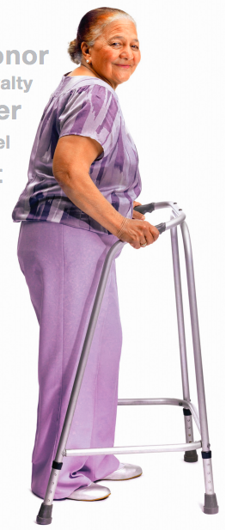
History
Physical
Setup
A/P
DM
CHF
HTN
CAD
Afib
COPD
Cataracts
Presbycusis
Constipation
Osteoporosis
Osteoarthritis
Oncychomycosis
Cognitive Impairment
Image: womenshealth.va.gov
Notes:
Image source:
Doctor
By Wilson Joseph
Licensed to Andrea Schwartz via thenounproject.com

Slide 17

The 4Ms
Image: womenshealth.va.gov
Tinetti, Molnar & Huang, JAGS 2017; Mate et al, HealthCare 2017; icons from thenounproject; design by A. Schwartz

Slide 18
The 4Ms
Image: womenshealth.va.gov
Tinetti, Molnar & Huang, JAGS 2017; Mate et al, HealthCare 2017; icons from thenounproject; design by A. Schwartz

Slide 19




History
Physical
Setup
A/P
Matters Most
Exploring Goals and Priorities
Advanced Care Planning
Notes:
Image source:
Doctor
By Wilson Joseph
Licensed to Andrea Schwartz via thenounproject.com

Slide 20




History
Physical
Setup
A/P
What does Polypharmacy look like?
Medications: Polypharmacy
See pill bottles
Medication setup
Medication list
Notes:
Image source:
Doctor
By Wilson Joseph
Licensed to Andrea Schwartz via thenounproject.com

Slide 21




History
Physical
Setup
A/P
Staying physically active at home
Screening for falls
Home Safety assessment
Mobility: Staying Active at Home Function Feet A Geriatrics Lens on Caring for Older Adults
Notes:
Image source:
Kung fu Stance
By Gan Khoon Lay
In the Qi Gong Chakra Power Collection
Licensed to Andrea Schwartz via thenounproject.com

Slide 22
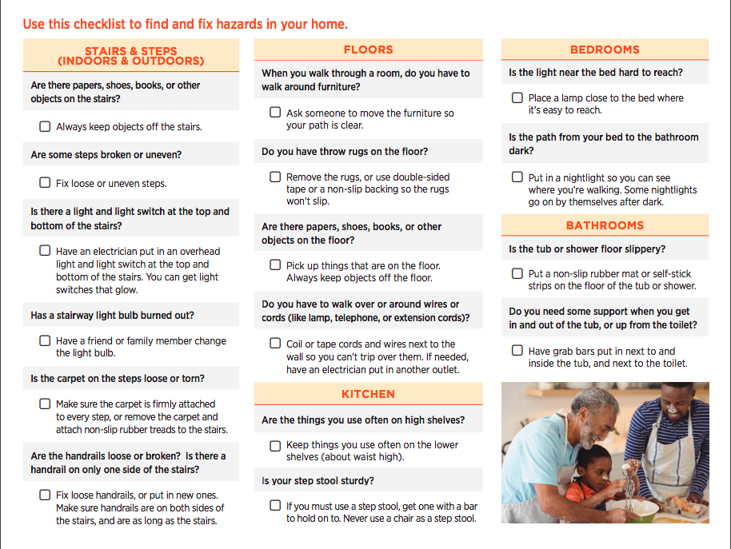
History
Physical
Setup
A/P
Staying physically active at home
Screening for falls
Home Safety assessment
Mobility: Staying Active at Home Function Feet A Geriatrics Lens on Caring for Older Adults
Notes:
Image source:
Doctor
By Wilson Joseph
Licensed to Andrea Schwartz via thenounproject.com

Slide 23
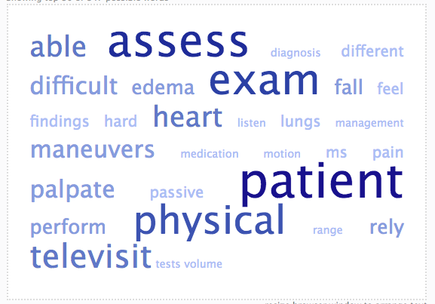
Setup
History
Physical
A/P
Notes:
Image source:
Doctor
By Wilson Joseph
Licensed to Andrea Schwartz via thenounproject.com

Slide 24
Setup
History
Physical
A/P
Notes:
Image source:
Doctor
By Wilson Joseph
Licensed to Andrea Schwartz via thenounproject.com

Slide 25
Setup
History
Physical
A/P
Observation
Environment
Grooming
General appearance
Mucous Membranes
Anicteric sclerae
Breathing comfortably
Mental status
Can involve patient or caregiver in exam
CDC Steadi; Reider et al, J. Geri PT 2015
Notes:
Image source:
Doctor
By Wilson Joseph
Licensed to Andrea Schwartz via thenounproject.com

Slide 26

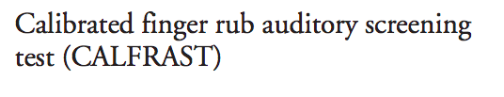
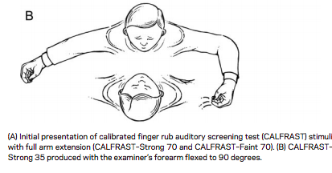
Setup
History
Physical
A/P
Mind: Hearing
Torres-Russoto et al, Neurology 2009
Notes:
Image source:
Doctor
By Wilson Joseph
Licensed to Andrea Schwartz via thenounproject.com

Slide 27
Setup
History
Physical
A/P
Mind: Mood and Cognition
Explore changes, stressors
Explore supports, coping mechanisms
Screen for Delirium:
Orientation to today
Months of the Year Backwards
Screen for cognitive impairment
Minicog
MOCA (validated for remote use)
Mocatest.org; Fick et al, Journal of Hospital Medicine, 2015
Notes:
Image source:
Doctor
By Wilson Joseph
Licensed to Andrea Schwartz via thenounproject.com

Slide 28
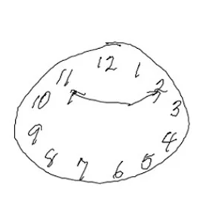
Setup
History
Physical
A/P
Mind: Memory
Repeat Three Words
Clock Draw
Recall Three Words
Borson, Miinicog, JAGS 2019.; Young et al, Journal of Telemed, 2018

Slide 29
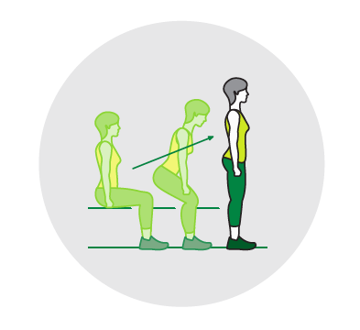
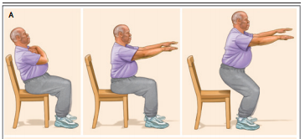
Setup
History
Physical
A/P
Mobility: Chair Stand Function Feet A Geriatrics Lens on Caring for Older Adults
CDC Steadi ; Ganz and latham, NEJM 2020

Slide 30

Setup
History
Physical
A/P
Instead, he spent much of the exam looking at her feet.
“Is that really necessary?”
she asked,
when he instructed her to
take off her shoes and socks.
“Yes,” he said.
After she’d left, he told me,
“You must always
examine the feet.”
Mobility: Feet Function Feet A Geriatrics Lens on Caring for Older Adults
Gawande, New Yorker 2007

Slide 31
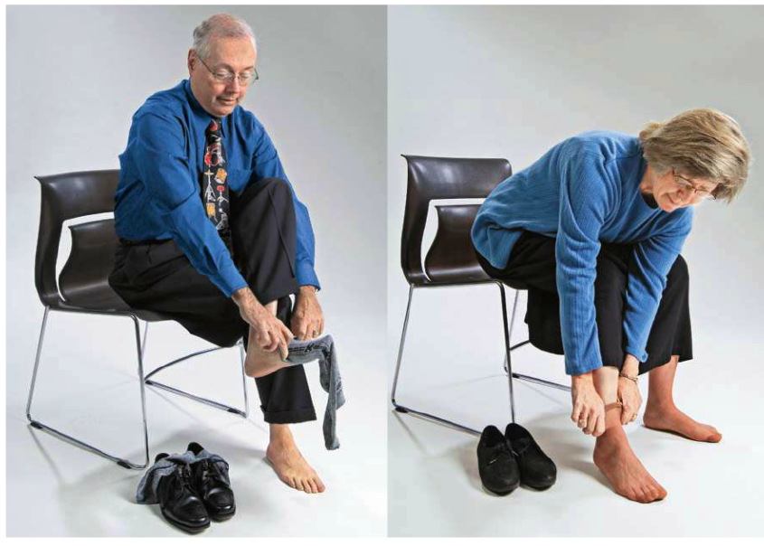
Setup
History
Physical
A/P
Mobility: Feet Function Feet A Geriatrics Lens on Caring for Older Adults
Sherman, Geriatrics 2007

Slide 32
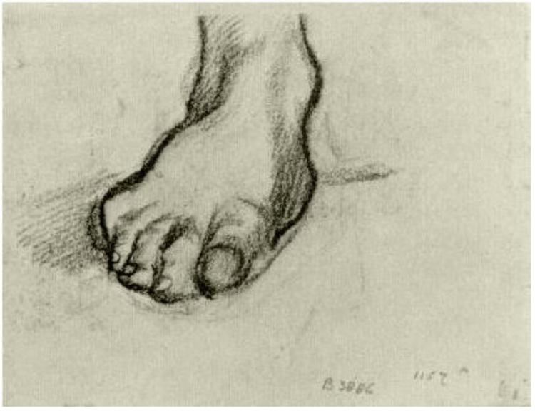
Setup
History
Physical
A/P
Fall risk
Mobility
Support
Self care
Adherence
Health literacy
Caregiver burden
Executive function
Financial resources
Mobility: Feet Function Feet A Geriatrics Lens on Caring for Older Adults
Van Gogh 1886’; Orkaby & Schwartz JAMA IM 2018

Slide 33
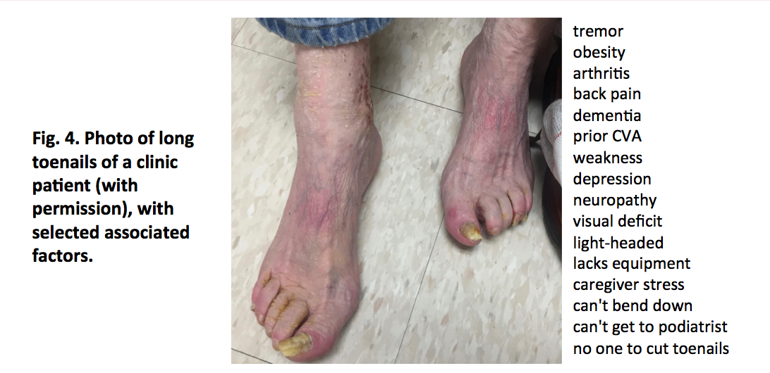
Setup
History
Physical
A/P
Mobility: Feet Function Feet A Geriatrics Lens on Caring for Older Adults
Growdon et al, AGS 2019; Orkaby & Schwartz, JAMA Internal Medicine 2019

Slide 34

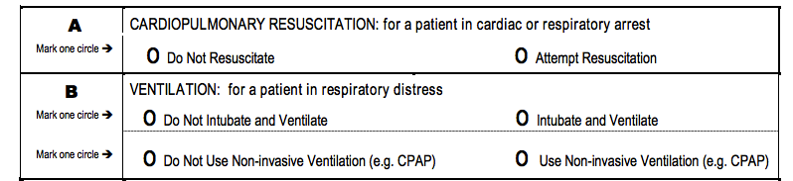
Setup
History
Physical
A/P
Matters Most
Consider logistics for MOLSTS (scan, fax, mail)
During COVID, Mass. allows witnessed phone consents
Notes:
Image source:
Doctor
By Wilson Joseph
Licensed to Andrea Schwartz via thenounproject.com

Slide 35
Setup
History
Physical
A/P
Matters Most
Caregiver support
Patient instructions
Interprofessional collaboration
Handouts/Information/Education
Any questions?
Let the patient end the call first
Notes:
Image source:
Doctor
By Wilson Joseph
Licensed to Andrea Schwartz via thenounproject.com

Slide 36
In person | Tele-visit
Introduction | Orient patient to video visit Establish emergency contact information
Make eye contact | Look directly at the camera, not necessarily at the patient’s picture on the screen
Speak loudly and clearly | Ensure microphone quality, consider using a headset for patient or clinician
Establish clear goals for the visit | Establish clear goals for the televisit, including determination of whether in-person follow up visit is necessary
Visit that includes caregivers and family members in exam room | Include even more caregivers and family members virtually
“Brown Bag” medication review | Patient holds medication bottles, pillbox or list up to screen
Perform observation, percussion, palpation, auscultation, and focused maneuvers on patient | Observe patient and their environment, engage patient or caregivers to assist with exam maneuvers such as the chair stand for mobility assessment
Education, instructions, paperwork printed for patient | Education, instructions, paperwork mailed or sent via secure message
Clinician leaves the room | Patient ends call
Sarah Oronato, Ashwini Joshi, Andrea Schwartz

Slide 37
The 4Ms
Image: womenshealth.va.gov
Tinetti, Molnar & Huang, JAGS 2017; Mate et al, HealthCare 2017; icons from thenounproject; design by A. Schwartz

Slide 38
andrea.schwartz@va.gov
The 4Ms in Telehealth visits
Andrea Wershof Schwartz, MD MPH
VA Boston Division of Geriatrics & Palliative Care
Assistant Professor of Medicine, Harvard Medical School
New England GRECC/Geriatrics Research, Education and Clinical Center

